Slide 1
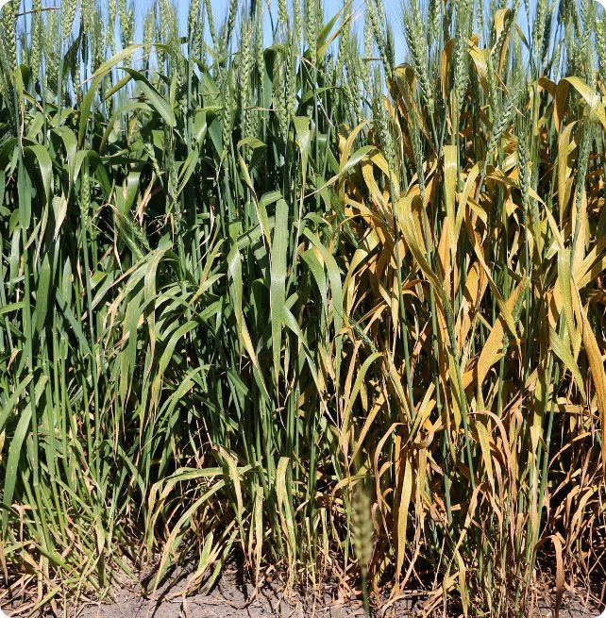
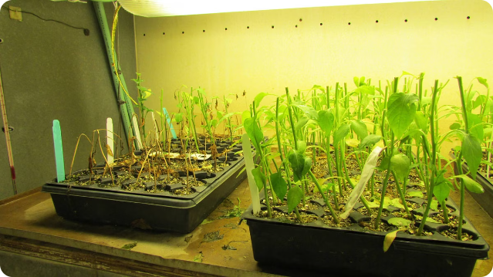
Introduction
Accurately identifying and diagnosing crop diseases is critical for maintaining healthy yields and sustainable agriculture. Machine learning offers powerful tools to automate this process, providing farmers with early detection and precise treatment solutions.
Challenges in Traditional Methods
Traditional methods of crop disease detection rely on visual inspection, which is time-consuming and prone to human error. Furthermore, the identification of diseases at an early stage is often challenging. Machine learning offers a promising solution to these challenges.
Types of Crop Diseases
Crop diseases can be broadly categorized into fungal, bacterial, and viral diseases. Each type presents unique challenges for detection and management. Machine learning algorithms can be trained to recognize patterns associated with these diseases, leading to more accurate and timely diagnosis.

Slide 2
Problem Identification
Prevent Yield Losses
Challenges in Traditional Disease Diagnosis
1
Early detection allows for timely intervention to stop the spread of disease and protect crop yields.
Subjective Assessments
Visual inspection can be prone to human error and inconsistency.
2
Reduce Chemical Use
Targeted treatment based on accurate diagnosis minimizes unnecessary pesticide application.
Time-Consuming Process
3
Ensure Food Security
Lab-based testing adds delays, preventing timely interventions.
Reliable crop health monitoring is crucial for global food supply and sustainability.

Slide 3
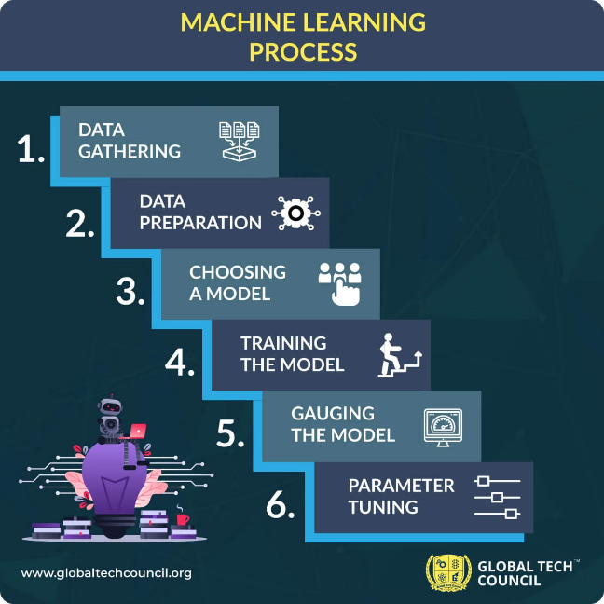
Methodology
Diverse Datasets
Building comprehensive datasets of healthy and diseased crop images is crucial.
Image Augmentation
Techniques like rotation, scaling, and flipping enhance model generalization.
Feature Engineering
Extracting relevant visual cues from images improves model accuracy.

Slide 4
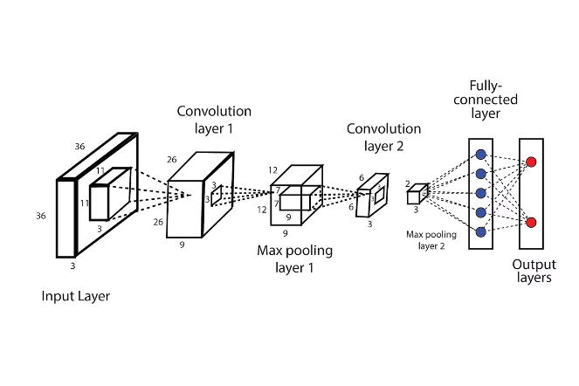
Machine Learning Algorithms Used
1. CNN
A Convolutional Neural Network (CNN) is a deep learning
algorithm widely used for image recognition and processing
tasks. It consists of multiple layers, including convolutional,
pooling, and fully connected layers, which automatically
and adaptively learn spatial hierarchies of features from
input images. The convolutional layers apply filters to detect
features such as edges, textures, and patterns, while pooling layers reduce dimensionality, enhancing computational
efficiency.
2. VGG16
VGG16 is a deep convolutional neural network model known for its simplicity and effectiveness, consisting of 16 layers with small 3x3 convolutional filters. with a fixed 2x2 max pooling layer after each set of convolutions. This design choice enables the network to capture intricate patterns while maintaining a manageable number of parameters.
This Photo by Unknown Author is licensed under CC BY

Slide 5
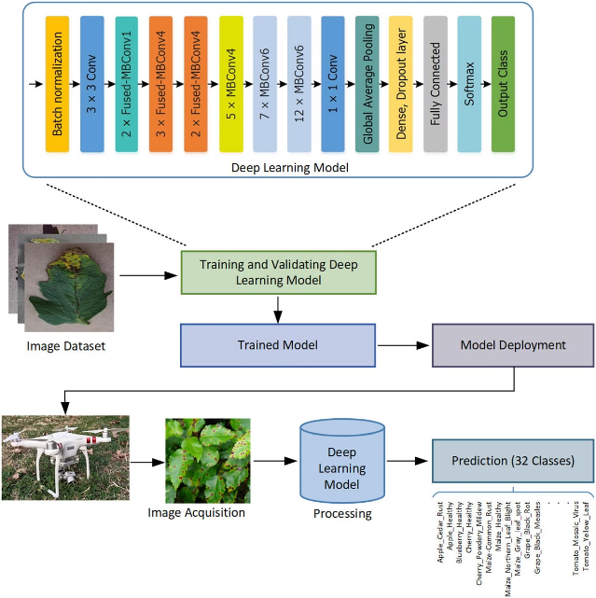
Machine Learning Algorithms Used
3. VGG19
VGG19 is a deep convolutional neural network that extends
the VGG16 architecture with 19 layers, providing increased
depth and feature extraction capabilities. It employs small 3x3
convolutional filters and widely used for image classification
and feature extraction in various computer vision tasks.
4 . ResNet50
ResNet50 is a deep convolutional neural network architecture
with 50 layers, designed to address the vanishing gradient
problem through use of residual learning and skip connections.
It is widely used for transfer learning in various applications
beyond image classification, such as object detection and semantic
segmentation.

Slide 6
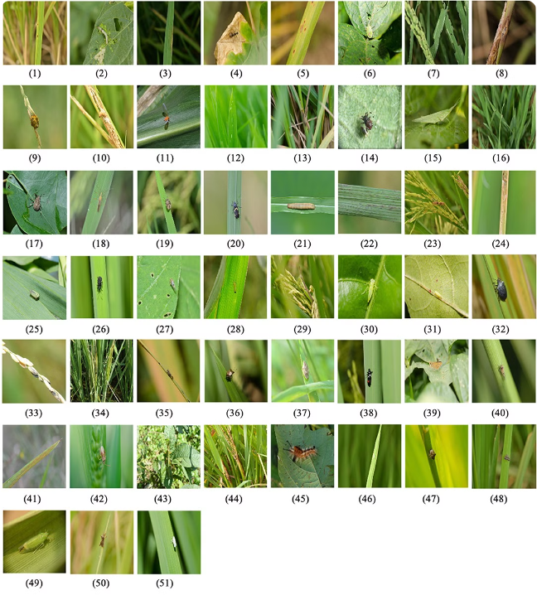
ML Algorithms Used
5.AlexNet
AlexNet is a pioneering deep convolutional neural network that won the ImageNet competition in 2012, featuring eight layers including five convolutional and three fully connected layers. It significantly advanced the field of computer vision by demonstrating the effectiveness of deep learning on large-scale image datasets.
6.Inception V3
Inception v3 is a deep convolutional neural network architecture that improves on its predecessors with an efficient grid-based design and factorized convolutions, enabling it to achieve high accuracy while maintaining computational efficiency. It was developed by Google and is widely used for image classification and recognition tasks.

Slide 7
Results and Discussion
In conclusion, the application of machine learning techniques in crop disease detection represents a significant leap forward in agricultural technology. By leveraging the power of data and advanced algorithms, we can enhance crop health, improve food security, and contribute to sustainable farming practices.
VGG16, VGG19, and AlexNet are foundational convolutional neural networks known for their impact on image classification, with VGG models utilizing small convolutional filters and AlexNet introducing deep learning to large-scale image datasets.
ResNet50 builds on this by incorporating residual learning and skip connections, allowing for the training of deeper networks without performance degradation.
Inception v3 outperforms the others in accuracy by leveraging an advanced architecture with efficient grid-based designs and factorized convolutions, making it the top choice for high-performance image classification and recognition tasks.

Slide 8
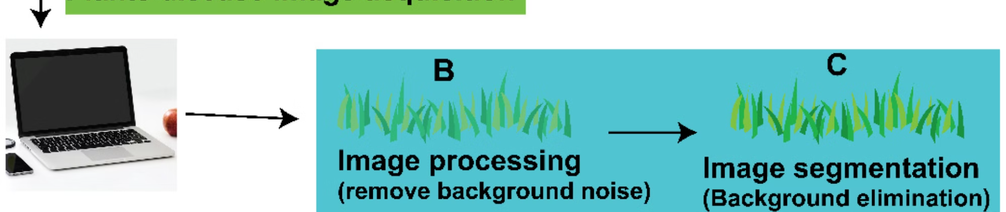
Conclusion and Future Work
1
Robust Solutions
2
Continued Innovation
3
Practical Integration
Machine learning empowers reliable, scalable, and cost-effective crop disease detection.
Exploring newer architectures and techniques can further improve model performance.
Integrating these solutions with smart farming technologies enables proactive crop management.

Slide 9


